Slide 1
Building WCC with OpenStack
Presenter’s Name - Presenter’s Title
DD Month Year

Slide 2
Summary
WCC will offer two value propositions in comparison to existing cloud solutions
The ability to specify and deploy multi-VM patterns including storage and network configuration
Today (e.g., EC2) such deployment is done by writing a topology-specific script using cloud APIs
IWD/vSys does not have reach enough the API to allow specifying network/storage artifacts
Combined with Weaver, we will get the ability to deploy and configure all aspects of workload via a single API call
Workload-optimized deployment and resource management
Today, only VMs are managed irrespective of network and storage resources
Generally, limited capabilities exist in VM management (IWD/IPAS is actually more advanced than competition in this regard)
WCC should be delivered in 2 phases
Phase 1: Deliver WCC API with the ability to specify and deploy multi-VM patterns including storage and network configuration
Clear value from user perspective
Can be done in the short term
Phase 2: Workload optimized resource management
Even greater value, but something customers will not try on day 1 – generally will be requested only after phase 1 is established
Depends on code that does not exist (e.g., topology discovery)
The architecture evolves according to these phases
Built around current OpenStack APIs – sufficient to deliver both phases
API extensions are used – we will work with OS to provide implementations if they don’t exist in reference implementation

Slide 3
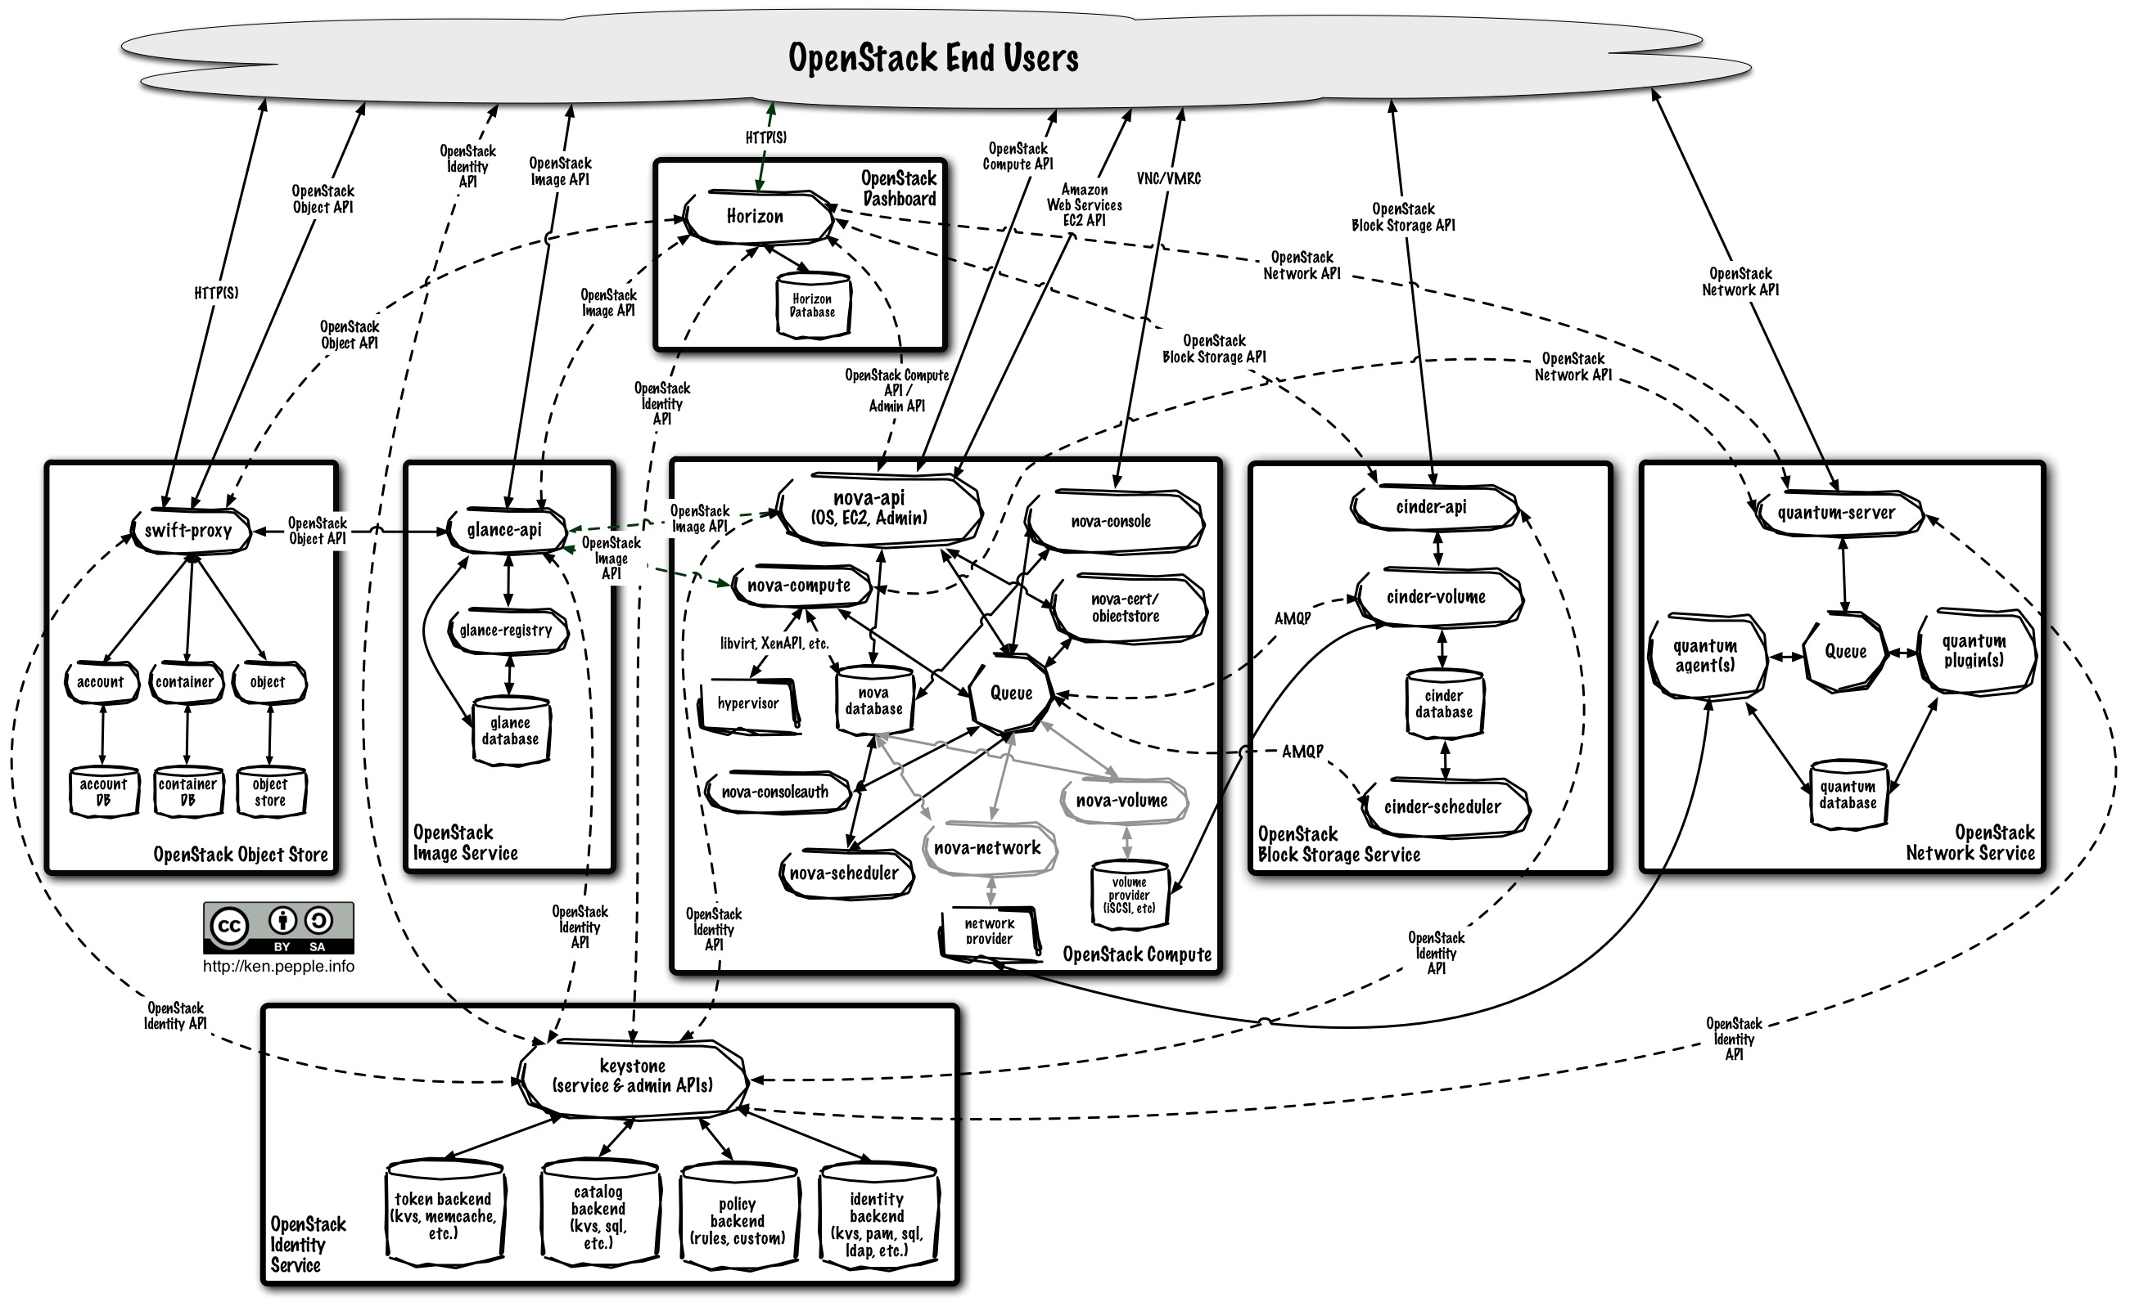
Current OpenStack architecture
IBM Presentation Template Full Version
Source: If applicable, describe source origin

Slide 4
WCC with openstack Phase 1
IWD
Weaver
WCC Service
WCC database
Dashboard
WCC API
Req Mgr
Adaptive
Executor
State
Collector
OpenStack
Compute API
OpenStack
Block API
SDN API
OpenStack
Object API
OpenStack
Image API
SDN
OpenStack
Identity API

Slide 5
WCC with openstack Phase 2
IWD
Weaver
WCC database
WCC API
Detailed data collection
Workload-aware Placement
Req Mgr
State Collector
Adaptive
Executor
WCC Service
OpenStack
Object API
OpenStack
Image API
OpenStack
Compute API
OpenStack
Block API
SDN API
SDN
scheduler
scheduler
OpenStack
Identity API

